Slide 1
Online Auction Platform Database System Project
Abhinav Borad: 115854642
Gunjan Deshpande : 116074863
Priyanshu Jain : 115962613
Stony Brook University
ISE 503: Database Management

Slide 2
Team Roles and Responsibilities
Abhinav : Designed the EER diagram for database system. Helped in developing the database on Postgresql and the connection with the driver while working on interesting queries.
Gunjan: Worked on UI using XAMPP, PHP, JS, HTML, CSS, postgresql and setting up the PowerPoint slides. Helped in creating interesting queries simultaneously while working on creating Report.
Priyanshu: Contributed to the development of database using postgresql & pgAdmin4 and the connection with the driver. Worked on UML diagram and compiling while working on interesting queries.

Slide 3
Overview
An online auction is a dynamic internet-based platform enabling the buying and selling of a wide array of products and services at competitive prices. In response to this growing trend, we developed a robust relational auction database system using PostgreSQL and pgAdmin 4 and the UML diagram was done via plantuml. Our system prioritizes reliability, simplicity, and efficiency.
This application empowers users to list and sell items, ranging from household goods to unique collectibles such as antique items, vibrant paintings, cutting-edge electronics, rare vintage musical instruments, valuable gold coins, elegant jewelry, luxurious cars, and stylish apparel. Designed to mirror the ease of navigating any standard website, our platform ensures accessibility for all users, including those without technical expertise, who can seamlessly engage with its features.

Slide 4
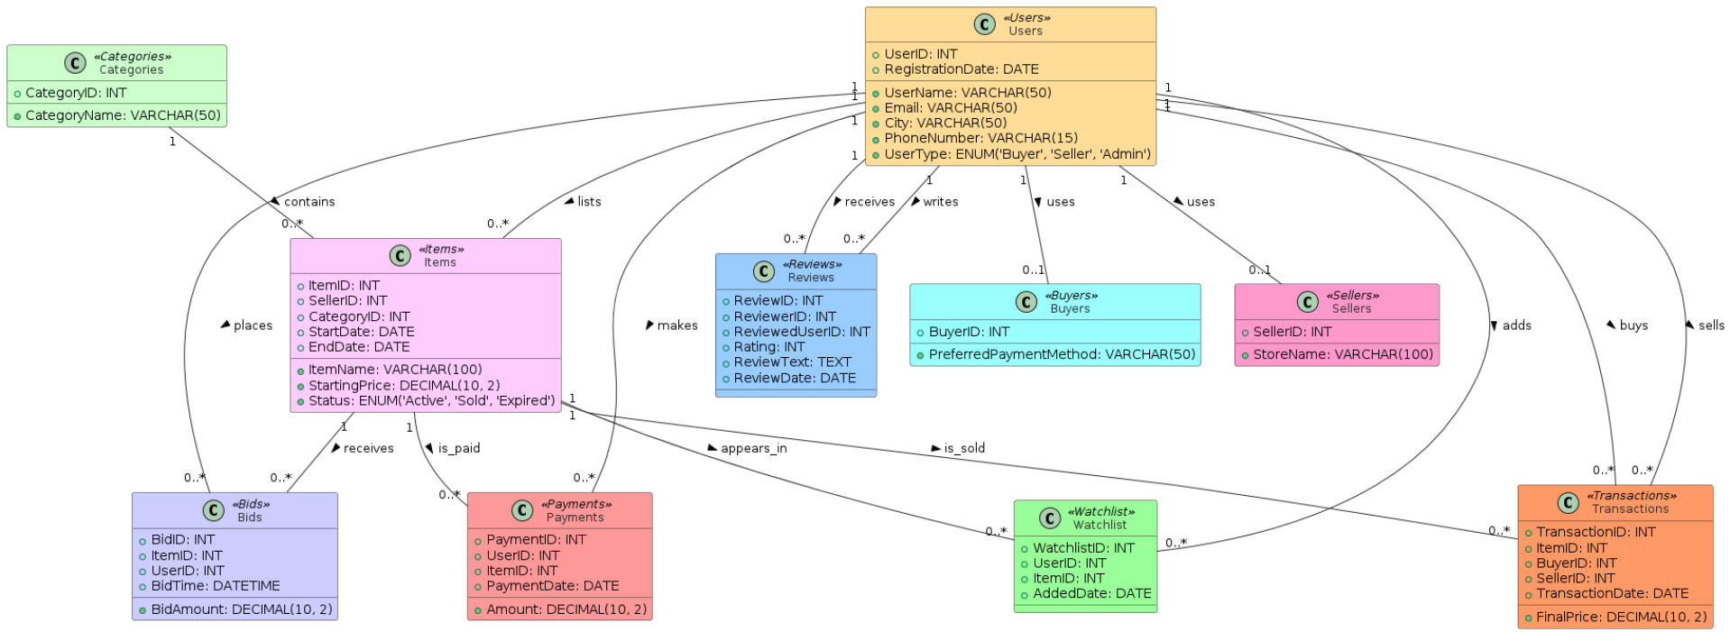
Project Design - UML Diagram

Slide 5
Entities & Corresponding Attributes
Some of the interesting Entities we used to create our Database are given below which explains about the usecase of in our database.
Users(UserID, UserName, Email, City, PhoneNumber, UserType, RegistrationDate)
This entity type contains information about the users in the database system.
Categories(CategoryID, CategoryName)
This entity type contains information about the categories in the database system.
Items(ItemID, SellerID, CategoryID, ItemName, StartingPrice, StartDate, EndDate, Status)
This entity type contains information about the items in the database system.
Bids(BidID, ItemID, UserID, BidAmount, BidTime)
This entity type contains information about the bids in the database system.
Payments(PaymentID, UserID, ItemID, Amount, PaymentDate)
This entity type contains information about the payments made for items and their associated user and item IDs.
Reviews(ReviewID, ReviewerID, ReviewedUserID, Rating, ReviewText, ReviewDate)
This entity type contains information about the reviews written by users and their associated reviewer and reviewed user IDs.
Watchlist(WatchlistID, UserID, ItemID, AddedDate)
This entity type contains information about the items added to users' watchlists and their associated user and item IDs.

Slide 6
Entities & Corresponding Attributes
Transactions(TransactionID, ItemID, BuyerID, SellerID, TransactionDate, FinalPrice)
This entity type contains information about the transactions of items and their associated buyer and seller IDs.
Buyers(BuyerID, PreferredPaymentMethod)
This entity type contains information about the buyers in the database system.
Sellers(SellerID, StoreName)
This entity type contains information about the sellers in the database system.
All of the attribute types for each of the entity types are simple, single-valued, and non-derived.
UserID, CategoryID, ItemID, BidID, PaymentID, ReviewID, WatchlistID, TransactionID, BuyerID, and SellerID are all primary keys for their corresponding entity types.
UserID is the foreign key for Buyers and Sellers.
SellerID and CategoryID are foreign keys for Items.
ItemID is the foreign key for Bids, Payments, Watchlist, and Transactions.
UserID is the foreign key for Bids, Payments, Watchlist, and Reviews (as ReviewerID and ReviewedUserID)

Slide 7
Relationships & Constraints
Multiple relationships and cardinalities in our database accurately reflect the complex interactions between entities like users, items, bids, and transactions. They ensure data integrity by defining how these entities connect, such as who can list items, place bids, or make payments. Cardinalities specify the nature of these connections, like one-to-many or one-to-one, ensuring our database structure mirrors real-world scenarios and user behaviors.
Some of them are:
1. Users to Items (One-to-Many):
A single user (acting as a seller) can list multiple items for auction. This relationship ensures that each item is linked to a specific seller, allowing the system to track who is selling each item.
Cardinality: Users "1" -- "0..*" Items : lists
2. Items to Bids (One-to-Many):
An item can receive multiple bids from different users. This relationship captures the competitive nature of auctions, where many users might place bids on the same item.
Cardinality: Items "1" -- "0..*" Bids : receives

Slide 8
Relationships & Constraints
3. Users to Reviews (One-to-Many):
A user can write multiple reviews for different items or sellers. This relationship helps in maintaining a feedback system where buyers can share their experiences.
Cardinality: Users "1" -- "0..*" Reviews : writes
4. Items to Transactions (One-to-Many):
An item can be involved in multiple transactions, typically reflecting cases where an item is relisted after a failed transaction. This relationship ensures the history of an item's sales is tracked.
Cardinality: Items "1" -- "0..*" Transactions : is_sold
5. Users to Watchlist (One-to-Many):
A user can add multiple items to their watchlist, allowing them to keep track of items they are interested in. This relationship supports user engagement by enabling them to monitor auctions of interest.
Cardinality: Users "1" -- "0..*" Watchlist : adds
6. Categories to Items (One-to-Many):
Each category can contain multiple items, helping to organize items into groups for easier navigation and search. This relationship supports the categorization of items in the auction system.
Cardinality: Categories "1" -- "0..*" Items : contains

Slide 9
Relationships & Constraints
7. Users to Sellers (One-to-One):
Each user can have a single seller profile. This relationship ensures that every user who acts as a seller has a unique seller profile associated with their user account, helping to manage and distinguish seller-specific information.
Cardinality: Users "1" -- "0..1" Sellers : uses
8. Users to Payments (One-to-Many):
Description: A user can make multiple payments for items they have purchased. This relationship ensures that each payment is linked to a specific user, helping to track the payment history.
Cardinality: Users "1" -- "0..*" Payments : makes >
9. Items to Categories (Many-to-One):
Multiple items can belong to a single category. This relationship helps organize items into groups for easier navigation and search, supporting the categorization of items in the auction system.
Cardinality: Items "0..*" -- "1" Categories : belongs_to

Slide 10
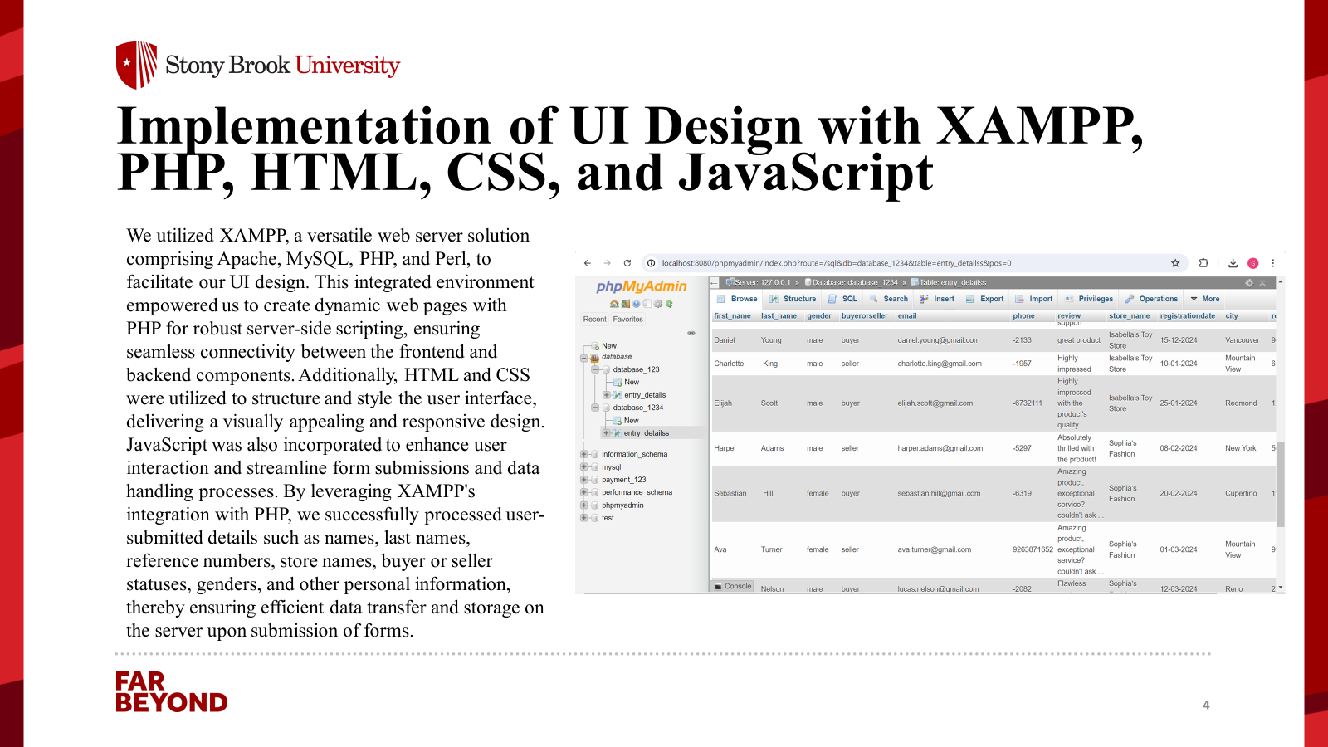

Slide 11
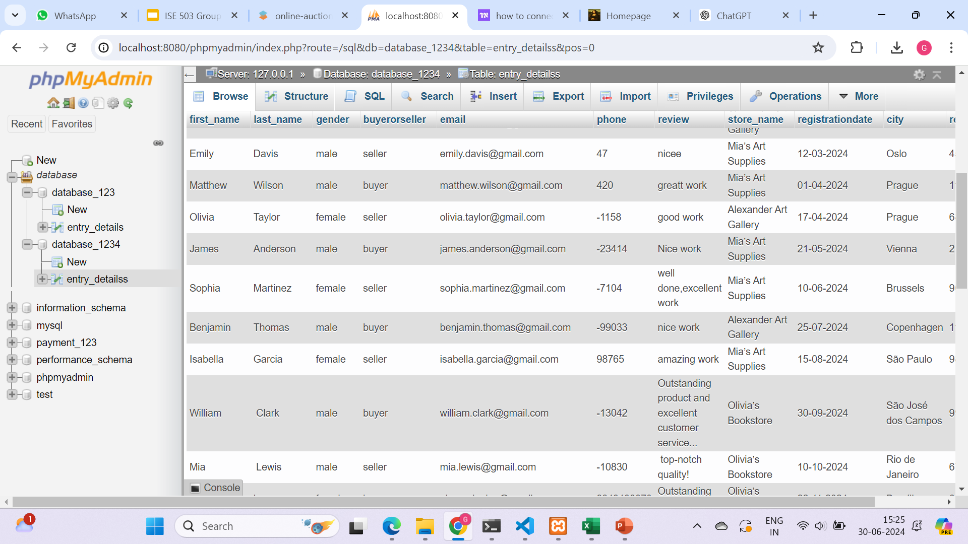
Critical Setup Instructions for PHP Script Execution in XAMPP
In our XAMPP environment, the PHP script details_entry.php plays a pivotal role in storing user inputs into the MySQL database "database_1234". It is imperative that details_entry.php is placed within the C:\xampp\htdocs directory on the C drive to ensure proper functionality. This setup is essential for seamless data processing and integrity within our project's backend infrastructure.

Slide 12
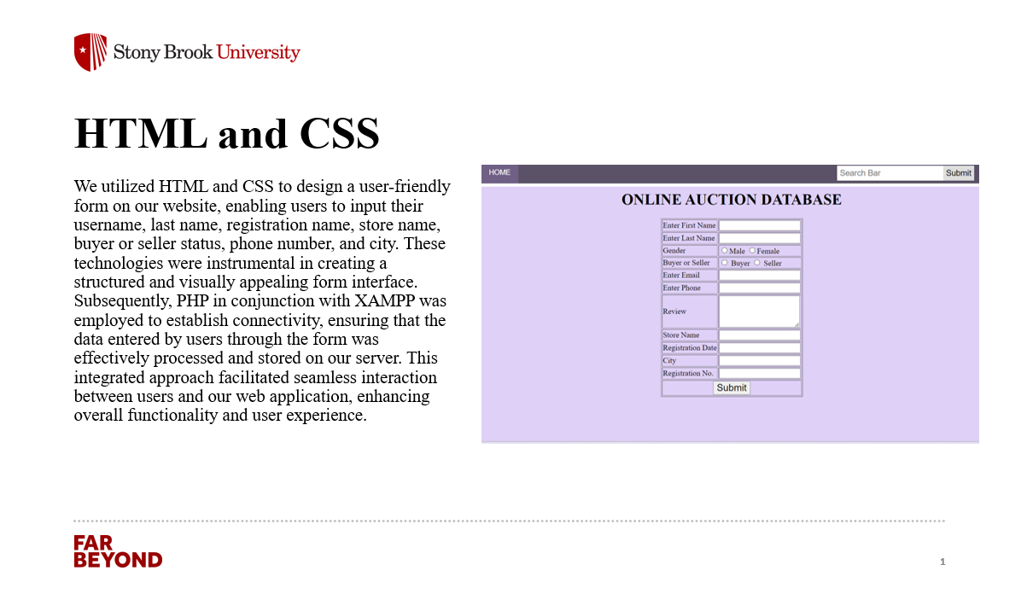

Slide 13
Interesting Questions & Queries
Via our database which includes the different entities, relationships and mock data, we have created different interesting questions which may help to provide more information about our dataset and even also explains about the usecase of our database.
1. What are the top 5 items with the highest individual bid amounts?
SELECT i.ItemName, MAX(b.BidAmount) AS HighestBid
FROM Items i
JOIN Bids b ON i.ItemID = b.ItemID
GROUP BY i.ItemName
ORDER BY HighestBid DESC
LIMIT 5;
This query finds the top 5 items that received the highest individual bids. It joins the Items and Bids tables, groups by item name, and selects the maximum bid amount for each item.
Expected Output: A list of the top 5 items with the highest bid amounts, showing the item names and the highest bids.

Slide 14
Interesting Questions & Queries
2. Which 7 categories have generated the most revenue?
SELECT c.CategoryName, SUM(t.FinalPrice) AS TotalRevenue
FROM Categories c
JOIN Items i ON c.CategoryID = i.CategoryID
JOIN Transactions t ON i.ItemID = t.ItemID
GROUP BY c.CategoryName
ORDER BY TotalRevenue DESC
LIMIT 7;
This query identifies the top 7 categories that have generated the most revenue. It joins the Categories, Items, and Transactions tables, groups by category name, and sums the final prices of transactions.
Expected Output: A list of the top 7 categories with the highest total revenues, showing category names and total revenue.

Slide 15
Interesting Questions & Queries
3. Evaluate the categories with the highest average item ratings based on the transactions, offering insights into category-specific buyer satisfaction levels.
SELECT c.CategoryName, ROUND(AVG(r.Rating)) AS AverageCategoryRating
FROM Categories c
JOIN Items i ON c.CategoryID = i.CategoryID
JOIN Transactions t ON i.ItemID = t.ItemID
JOIN Reviews r ON r.ReviewedUserID = t.SellerID
GROUP BY c.CategoryName
ORDER BY AverageCategoryRating DESC
LIMIT 5;
This query calculates the average item rating for each category based on reviews. It joins the Categories, Items, Transactions, and Reviews tables, groups by category name, and averages the ratings.
Expected Output: A list of the top 5 categories with the highest average item ratings, showing category names and average ratings.

Slide 16
Interesting Questions & Queries
4. Identify the users who have placed the highest number of bids across all auctions, and analyze their average bid amounts to understand their bidding behavior?
SELECT u.UserName, COUNT(b.BidID) AS TotalBids, ROUND(AVG(b.BidAmount)) AS AverageBidAmount
FROM Users u
JOIN Bids b ON u.UserID = b.UserID
GROUP BY u.UserName
ORDER BY TotalBids DESC
LIMIT 5;
This query finds the users who have placed the most bids and calculates their average bid amounts. It joins the Users and Bids tables, groups by user name, and counts and averages the bid amounts.
Expected Output: A list of the top 5 users with the highest number of bids, showing user names, total bids, and average bid amounts.

Slide 17
Interesting Questions & Queries
5. Assess the distribution of payment methods utilized by buyers and determine the most preferred payment method, highlighting trends in buyer preferences.
SELECT b.PreferredPaymentMethod, COUNT(p.PaymentID) AS NumberOfPayments
FROM Buyers b
JOIN Payments p ON b.BuyerID = p.UserID
GROUP BY b.PreferredPaymentMethod
ORDER BY NumberOfPayments DESC;
This query analyzes the distribution of payment methods used by buyers and identifies the most preferred method. It joins the Buyers and Payments tables, groups by payment method, and counts the payments.
Expected Output: A list of payment methods and the number of payments for each, showing the most preferred methods.

Slide 18
Interesting Questions & Queries
6. Examine the top five most expensive items sold on the platform, detailing the sellers and buyers involved to provide context on high-value transactions.
SELECT i.ItemName, t.FinalPrice, u1.UserName AS Seller, u2.UserName AS Buyer
FROM Items i
JOIN Transactions t ON i.ItemID = t.ItemID
JOIN Users u1 ON t.SellerID = u1.UserID
JOIN Users u2 ON t.BuyerID = u2.UserID
ORDER BY t.FinalPrice DESC
LIMIT 5;
This query identifies the top 5 most expensive items sold, along with the sellers and buyers involved. It joins the Items, Transactions, and Users tables, and orders by final price.
Expected Output: A list of the top 5 most expensive items, showing item names, final prices, seller names, and buyer names.

Slide 19
Interesting Questions & Queries
7. Identify the items that have achieved the highest bid-to-starting price ratio, providing insights into items that attracted significantly higher bids compared to their initial listing prices.
SELECT i.ItemName, i.StartingPrice, MAX(b.BidAmount) AS HighestBid, ROUND((MAX(b.BidAmount)) / i.StartingPrice) AS BidToStartRatio
FROM Items i
JOIN Bids b ON i.ItemID = b.ItemID
GROUP BY i.ItemName, i.StartingPrice
ORDER BY BidToStartRatio DESC
LIMIT 5;
This query calculates the bid-to-starting price ratio for each item and identifies the items with the highest ratios. It joins the Items and Bids tables, groups by item name and starting price, and calculates the ratio.
Expected Output: A list of items with the highest bid-to-starting price ratios, showing item names, starting prices, highest bids, and ratios.

Slide 20
Interesting Questions & Queries
8. Identify the top five sellers who have achieved the highest average final selling price for their auctioned items, providing insights into their pricing strategies.
SELECT s.StoreName, ROUND(AVG(t.FinalPrice)) AS AverageSellingPrice
FROM Sellers s
JOIN Users u ON s.SellerID = u.UserID
JOIN Transactions t ON u.UserID = t.SellerID
GROUP BY s.StoreName
ORDER BY AverageSellingPrice DESC
LIMIT 5;
This query finds the sellers with the highest average final selling prices for their items. It joins the Sellers, Users, and Transactions tables, groups by store name, and averages the final prices.
Expected Output: A list of the top 5 sellers with the highest average selling prices, showing store names and average selling prices.

Slide 21
Interesting Questions & Queries
9. Determine the top 5 users with the highest total bid amounts in the last month, and provide details of their highest single bid within that period.
WITH UserTotalBidsLastMonth AS (
SELECT
b.UserID,
u.UserName,
SUM(b.BidAmount) AS TotalBidAmount,
MAX(b.BidTime) AS LatestBidTime
FROM
Bids b
JOIN
Users u ON b.UserID = u.UserID
WHERE
b.BidTime >= DATE_TRUNC('month', CURRENT_DATE) - INTERVAL '1 month'
AND b.BidTime < DATE_TRUNC('month', CURRENT_DATE)
GROUP BY
b.UserID, u.UserName
),
RankedUsers AS (
SELECT
UserID,
UserName,
TotalBidAmount,
LatestBidTime,
RANK() OVER (ORDER BY TotalBidAmount DESC) AS Rank
FROM
UserTotalBidsLastMonth
)
SELECT
UserID,
UserName,
TotalBidAmount,
LatestBidTime
FROM
RankedUsers
WHERE
Rank <= 5;
This query finds the sellers with the highest average final selling prices for their items. It joins the Sellers, Users, and Transactions tables, groups by store name, and averages the final prices.
Expected Output: A list of the top 5 sellers with the highest average selling prices, showing store names and average selling prices.

Slide 22
Interesting Questions & Queries
10. Identify the items with the highest number of unique bidders in the last three months and provide details of the highest bid for each of these items.
WITH ItemUniqueBiddersLastThreeMonths AS (
SELECT
i.ItemID,
i.ItemName,
COUNT(DISTINCT b.UserID) AS UniqueBidders
FROM
Items i
JOIN
Bids b ON i.ItemID = b.ItemID
WHERE
b.BidTime >= (CURRENT_DATE - INTERVAL '3 MONTHS')
GROUP BY
i.ItemID, i.ItemName
),
RankedItems AS (
SELECT
ItemID,
ItemName,
UniqueBidders,
RANK() OVER (ORDER BY UniqueBidders DESC) AS Rank
FROM
ItemUniqueBiddersLastThreeMonths
)
SELECT
ri.ItemID,
ri.ItemName,
ri.UniqueBidders,
b.UserID AS HighestBidderID,
u.UserName AS HighestBidderName,
b.BidAmount AS HighestBidAmount
FROM
RankedItems ri
JOIN
Bids b ON ri.ItemID = b.ItemID
JOIN
Users u ON b.UserID = u.UserID
WHERE
b.BidAmount = (SELECT MAX(b2.BidAmount) FROM Bids b
AND ri.Rank <= 5
ORDER BY ri.Rank;
This query identifies items with the highest number of unique bidders in the last three months and provides details of the highest bid for each item. It uses a common table expression (CTE) to calculate unique bidders and ranks items.
Expected Output: A list of items with the highest number of unique bidders in the last three months, showing item names, unique bidders, highest bidder names, and highest bid amounts.

Slide 23
CONCLUSION
Our analysis of the online auction platform database reveals valuable insights into user behavior, item popularity, and platform performance. We identified top-performing items and categories, highlighting areas for targeted marketing and inventory optimization.
The analysis of buyer satisfaction through average item ratings guides product quality improvements, while understanding active bidders and payment preferences helps tailor promotions and transaction processes. Examining high-value transactions and bidding dynamics provides context for pricing strategies, and identifying top sellers offers best practices for others to emulate. Monthly bidding trends and items with broad appeal further inform engagement strategies and inventory decisions, ensuring a data-driven approach to enhancing platform success.

Slide 24
Thank you.

